Slide 1

ICBP 2.0
The Smartest AI Nutrition Assistant
Your Name : Hiren Raval
Project GitHub Link: https://github.com/raval3210/The-Smartest-AI-Nutrition-Assistant

Slide 2
Content
Problem Statement
Objectives
Key Technologies
Core Features
Architecture
Modules
Results
Conclusion
Future Work
Notes:
Here we are going to learn,
Text classification involves assigning categories to text, commonly applied in spam detection. It requires preprocessing (tokenization, stopword removal) and vectorization (e.g., TF-IDF). Models like Naive Bayes or Logistic Regression are trained and evaluated using metrics like accuracy and F1-score.

Slide 3
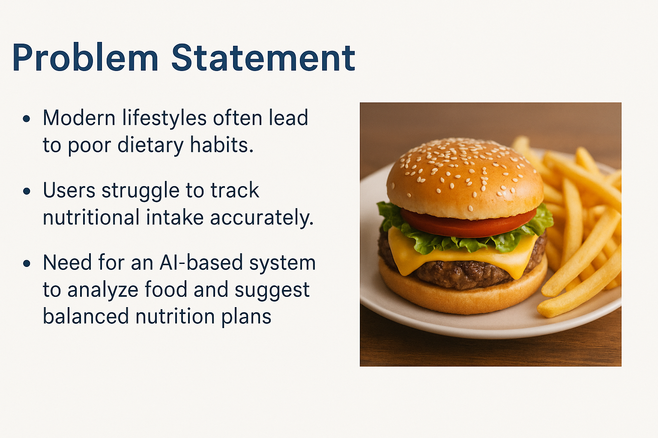
Problem Statement
Notes:
Need to discuss about :
What problem are you solving?
Why is it important?

Slide 4
Objective
Objectives
To build an intelligent, interactive nutrition assistant using generative AI that provides:
Automate meal identification from images or descriptions.
Provide nutritional breakdown using trusted databases.
Suggest healthy meal plans and alternatives.
Notes:
Need to discuss about :
Clear goals of the project
What you aim to achieve with AI/ML/DL

Slide 5
Objective
Key Technologies
Machine Learning: Sentence Transformers, BLIP-2 for image captioning, Hugging Face models.
NLP: Transformers for understanding meal descriptions.
Data: USDA FoodData Central Dataset.
Web Interface: Gradio for interaction.
Utilities: Python, Pandas, NumPy, PIL.
Notes:
Need to discuss about :
Clear goals of the project
What you aim to achieve with AI/ML/DL

Slide 6
Objective
Core Features
Image-based meal recognition using BLIP-2.
Text-based food input and natural language queries.
Nutrition breakdown using USDA dataset.
Meal plan generation and health suggestions.
Notes:
Need to discuss about :
Clear goals of the project
What you aim to achieve with AI/ML/DL

Slide 7
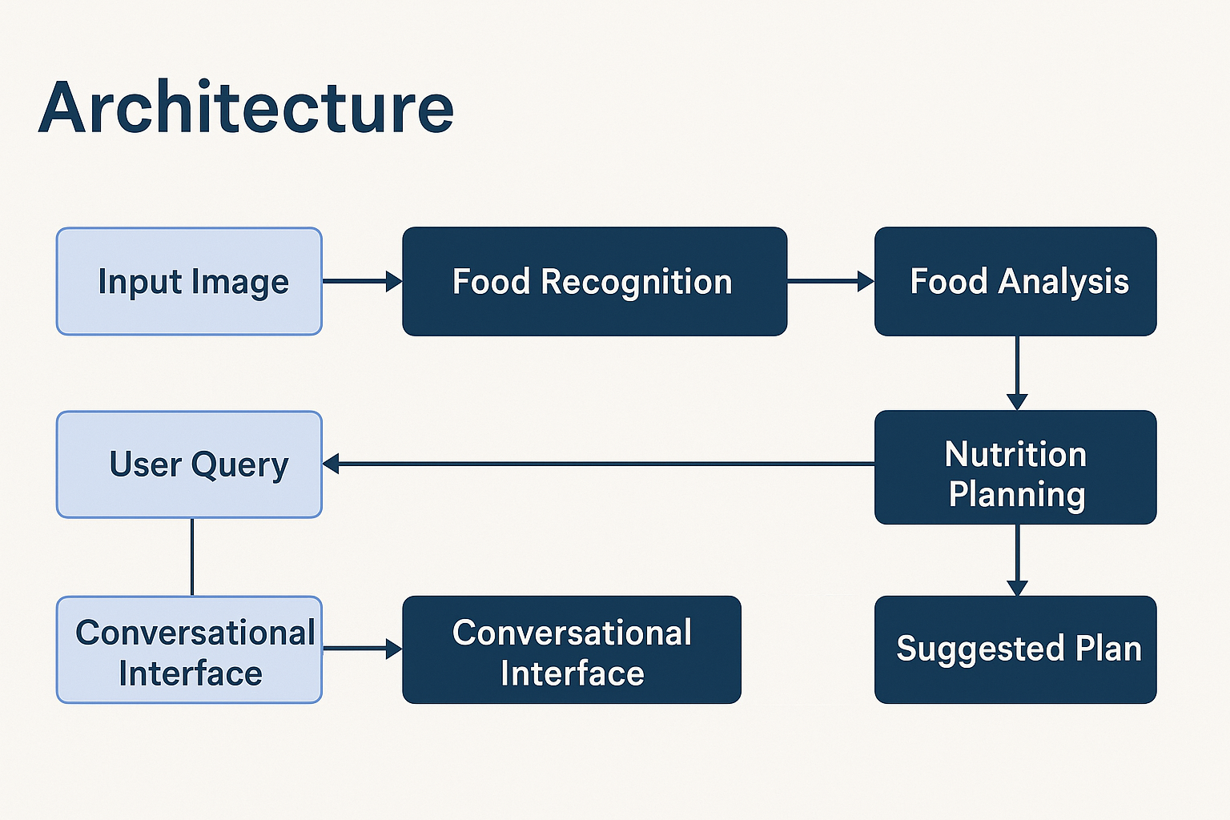
Objective
Architecture
Frontend: Gradio-based UI for user interaction.
Processing Layer:
Image processor (BLIP-2),
Text processor (Sentence-BERT),
Nutrition calculator.
Backend:
Data handler using USDA dataset.
Inference engine for nutritional insights.
Notes:
Need to discuss about :
Clear goals of the project
What you aim to achieve with AI/ML/DL

Slide 8
Objective
Modules
Image Captioning Agent: BLIP-2 model to describe food images.
Nutrient Analyzer: Extracts calorie, protein, fat, and carb values.
Text Embedding Agent: Embeds food descriptions for similarity search.
Data Module: Handles USDA dataset or fallback sample data.
Notes:
Need to discuss about :
Clear goals of the project
What you aim to achieve with AI/ML/DL

Slide 9
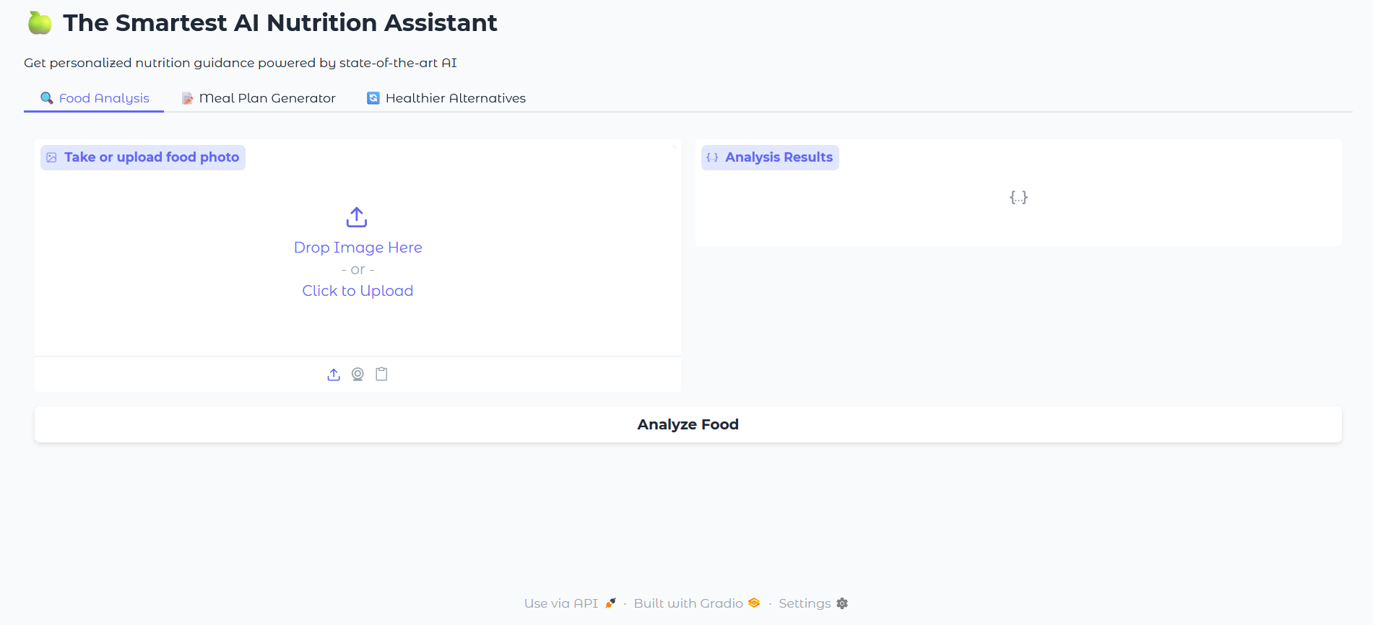
Objective
Results
Functional interface for uploading food images or entering text.
Returns precise nutrition facts per 100g for common foods.
Performs with fallback logic if dataset is unavailable.
Notes:
Need to discuss about :
Clear goals of the project
What you aim to achieve with AI/ML/DL

Slide 10
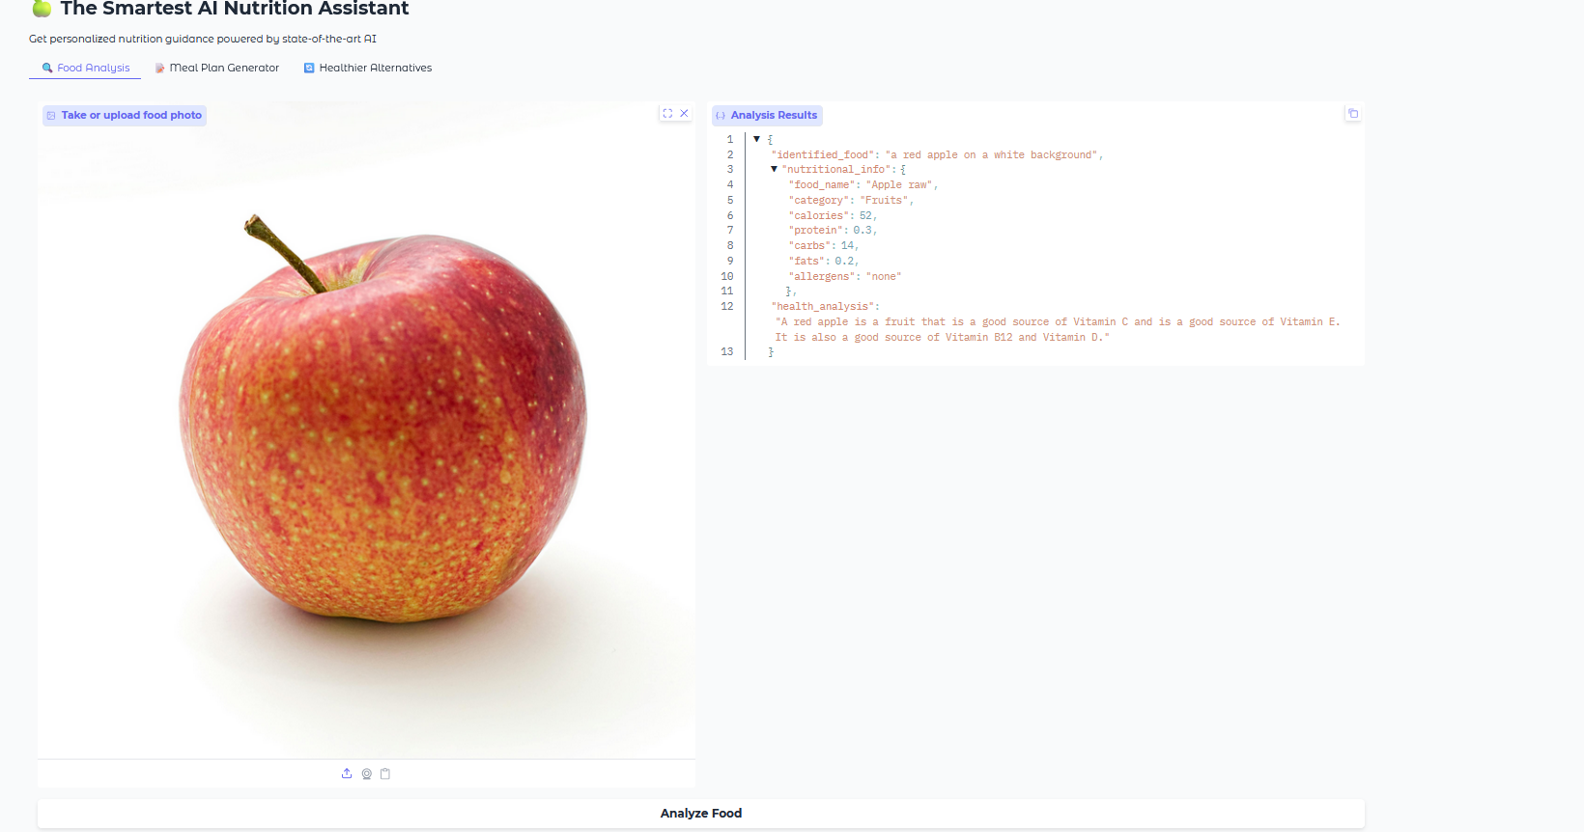
Objective
Results
Notes:
Need to discuss about :
Clear goals of the project
What you aim to achieve with AI/ML/DL

Slide 11
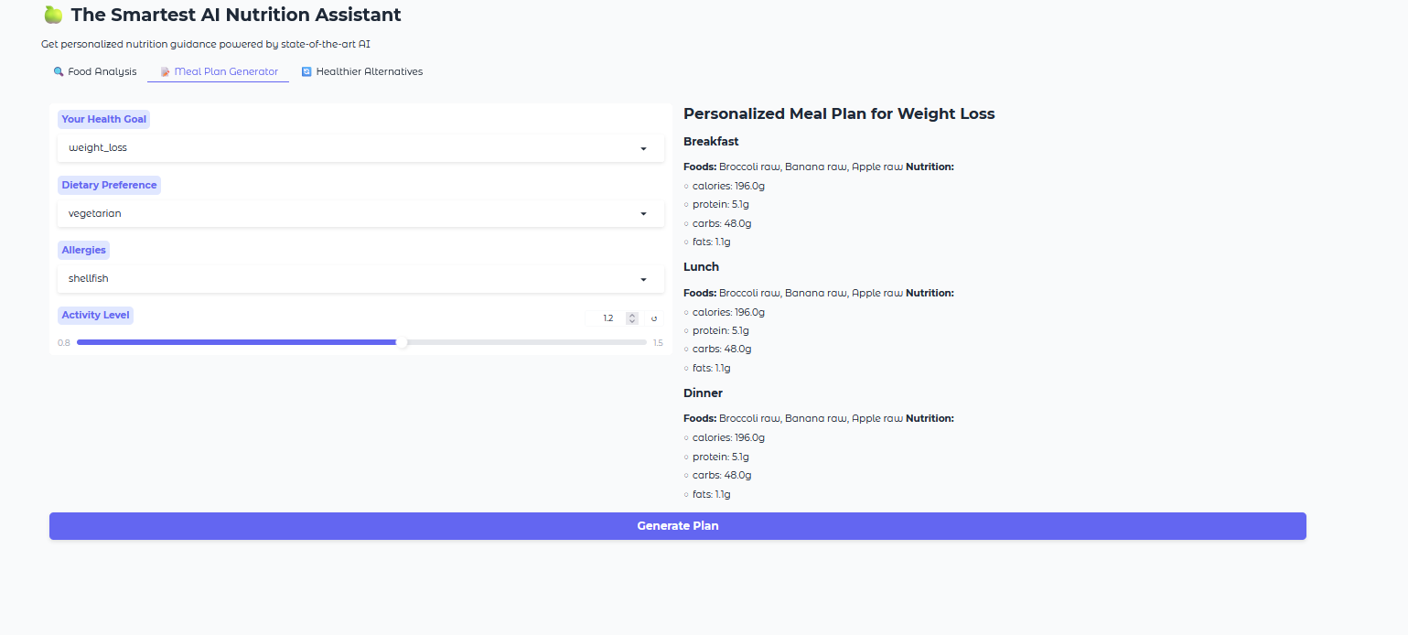
Objective
Results
Notes:
Need to discuss about :
Clear goals of the project
What you aim to achieve with AI/ML/DL

Slide 12
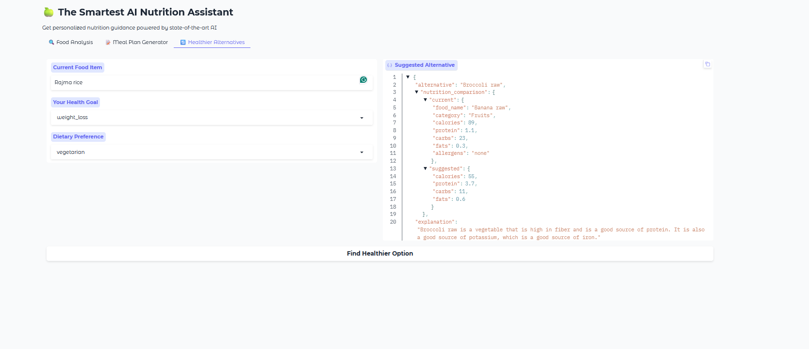
Objective
Results
Notes:
Need to discuss about :
Clear goals of the project
What you aim to achieve with AI/ML/DL

Slide 13
Objective
Conclusion
Successfully demonstrates a multi-modal nutrition assistant.
Future Enhancements:
Real-time voice input support.
Personalized diet tracking.
Integration with wearables for health monitoring.
Notes:
Need to discuss about :
Clear goals of the project
What you aim to achieve with AI/ML/DL

Slide 14
Objective
References
Hugging Face Transformers and Datasets.
USDA FoodData Central: https://fdc.nal.usda.gov
BLIP-2: Salesforce AI Research.
Gradio: https://www.gradio.app
Notes:
Need to discuss about :
Clear goals of the project
What you aim to achieve with AI/ML/DL

Slide 15
Thank You

